Slide 1

Project 2 – Jobs Analysis
Adzure Job Search

Slide 2
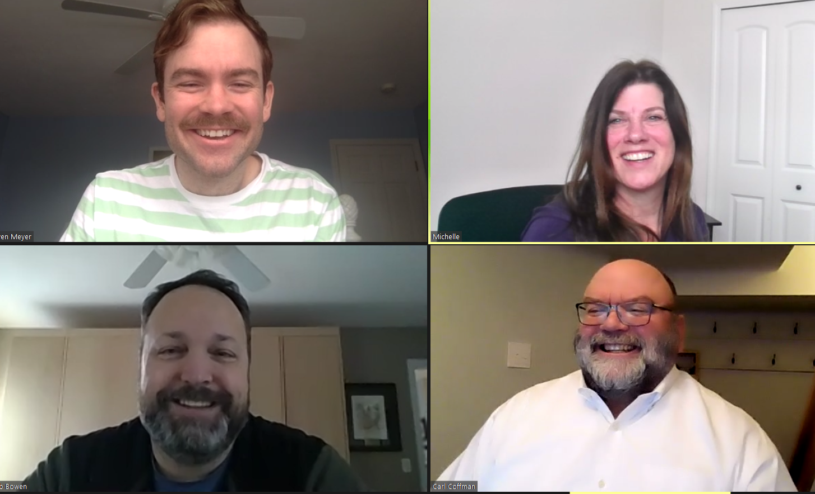
Meet the dream team!
Owen Meyer
Michelle Bannon
Rob Bowen
Carl Coffman

Slide 3
Project Challenges
Getting data
Getting data:
API’s required a paid subscription
Indeed (restricted number of pages)
LinkedIn
Glass Door
Parshub
Decided on an API’s for Adzula salary was generally null
Running out of our API data, exceeding our daily limit
Getting good data from the API; Less than 5% had salary data

Slide 4

Project challenges Continued
GIT HUB SAYS YOUR CHANGES ARE REJECTED!

Slide 5
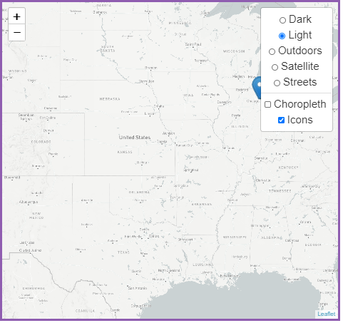
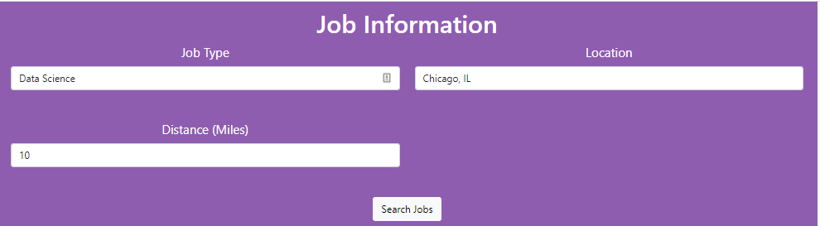
The web page provides users an interactive means to explore data
Select the Job Type, location and distance to the
Location. Click search
Zoom in and out of the map for the locations of the available jobs

Slide 6
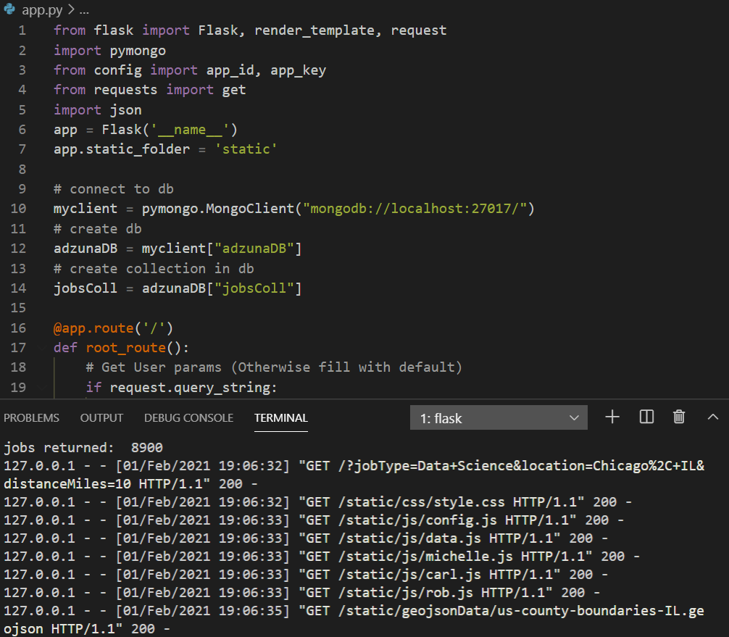
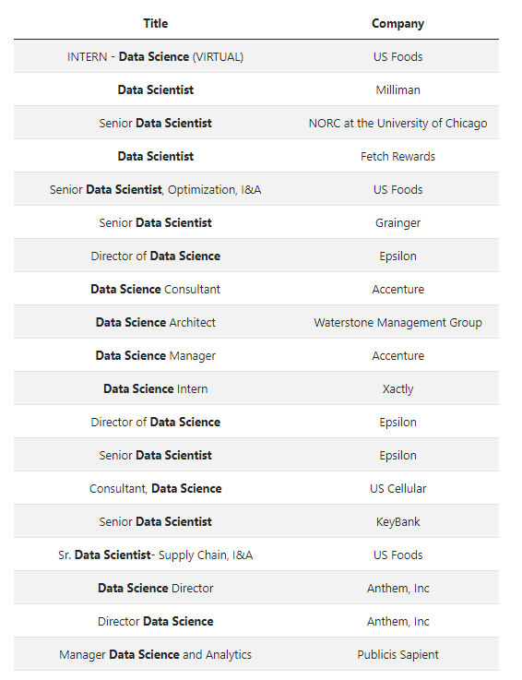
Used flask Python to pull data
Flask returned all the jobs for that job, location and radius

Slide 7
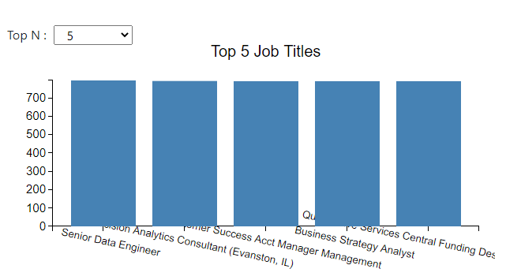
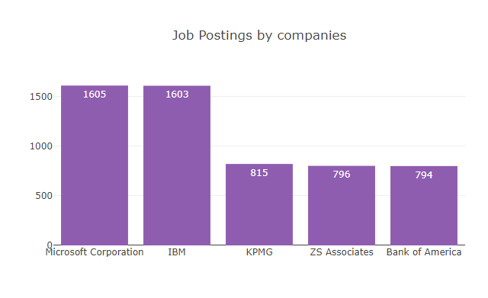
Based on the search criteria, several questions are answered
What are the top 5 Job Titles?
Where are the companies located?
What are the top 5 companies that have the most jobs for the selected job title?

Slide 8
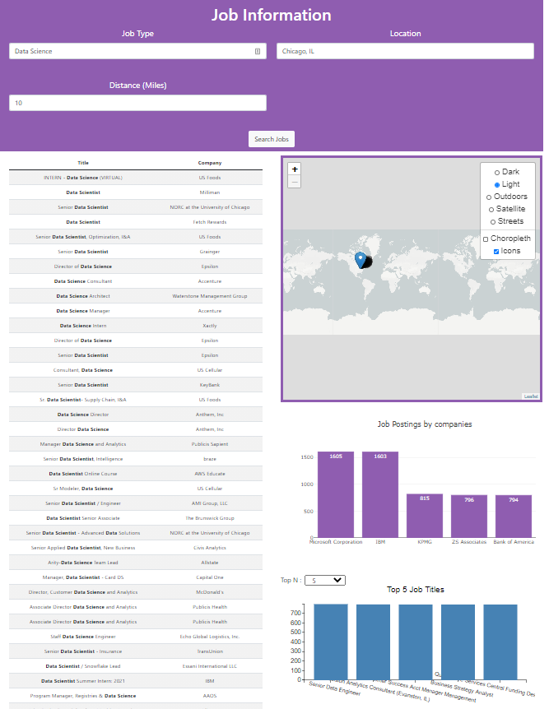
The result is a dashboard page with multiple charts that update from the same data
Data Science search returned 8900 records (YIKES!)

Slide 9
Any Questions?

Slide 10
BACKUP SLIDES
Backup

Slide 11
Project Description
Tell a story with data visualization
Focus on providing users an interactive means to explore data themselves. If daily source can’t be found, warehouse daily to build missing data
Prepare a 5-minute presentation that lays out your theme, coding approach, data munging techniques, and final visualization.
You may choose a project of any theme, but we encourage you to think broadly.
You will have ample time in class to work with your group, but expect to put in hours outside of class as well.

Slide 12
Project Requirements
Your visualization must include a Python Flask–powered API, HTML/CSS, JavaScript, and at least one database (SQL, MongoDB, SQLite, etc.).
Your project should fall into one of the below four tracks:
A custom “creative” D3.js project (i.e., a nonstandard graph or chart)
A combination of web scraping and Leaflet or Plotly
A dashboard page with multiple charts that update from the same data
A “thick” server that performs multiple manipulations on data in a database prior to visualization (must be approved)
Your project should include at least one JS library that we did not cover.
Your project must be powered by a data set with at least 100 records.
Your project must include some level of user-driven interaction (e.g., menus, dropdowns, textboxes).
Your final visualization should ideally include at least three views.

